Slide 1
Test Driven Development (TDD)
Presentation Subtitle Arial Regular 20/24pt

Slide 2
What is TDD?
Benefits of TDD
Conventional approach vs TDD approach
TDD Best Practice

Slide 3
“No amount of testing can prove a software right, but a single test can prove a software wrong.” - Amir Ghahrai
Notes:
5 minutes
In Maths view, it is a IFF case
About Amir https://www.linkedin.com/pub/dir/Amir/Ghahrai
Founder of TestingExcellence.com A Senior QA Engineer with over 15 years experience in Information Technology in particular Testing and...

Slide 4
Software development process that relies on the repetition of a very short development cycle: requirements are turned into very specific test cases, then the software is improved to pass the new tests, only.
Wikipedia
Notes:
This is opposed to software development that allows software to be added that is not proven to meet requirements.

Slide 5
What is TDD?

Slide 6
What is TDD?
About “Design”
Not about testing…test first, then design code
Short development iterations
Forces constant integration eg. produces code to necessary pass test cases
Developers write tests
Gives confidence in code. Get direct feedback!
It’s automated!
Notes:
5 minutes
Question to audience – Do you think you test enough ?
If Yes. How much is enough ? If you spend 10 days to write code, how many days you spend to test code ?

Slide 7
Why don’t we do TDD?
Don’t know how to set up
Where can we find the tools and which tools will fit?
Tests are too complex or too deep
Some scenarios are too complicated or can’t be tested!
Too much to test, where to start?
Some large applications don’t have unit tests.
NOT ENOUGH TIME!!!
Notes:
10 minutes
testing of legacy monolithic systems is hard
change of design methodology in microservices is easier and there more boundaries
=== LIMITATION ===
Test-driven development does not perform sufficient testing in situations where full functional tests are required to determine success or failure, due to extensive use of unit tests.^{[21]} Examples of these are user interfaces, programs that work with databases, and some that depend on specific network configurations. TDD encourages developers to put the minimum amount of code into such modules and to maximize the logic that is in testable library code, using fakes and mocks to represent the outside world.

Slide 8
Benefits of TDD

Slide 9
Results
Higher code quality
Maintainability
Flexibility
Predictability
…….
A well designed application!
Notes:
5 minutes
Expect 80% coverage of TDD

Slide 10
Conventional approach vs TDD approach

Slide 11
Conventional approach
2. Code
1. Design
3. Test
Notes:
1 minute
Drawback is that testing will always be cut short

Slide 12
New approach
2. Test
1. Design
3. Code
Notes:
5 minute
1. Design and Add a test - In test-driven development, each new feature begins with writing a test. Write a test that defines a function or improvements of a function, which should be very succinct. To write a test, the developer must clearly understand the feature's specification and requirements. The developer can accomplish this through use cases and user stories to cover the requirements and exception conditions, and can write the test in whatever testing framework is appropriate to the software environment. It could be a modified version of an existing test. This is a differentiating feature of test-driven development versus writing unit tests after the code is written: it makes the developer focus on the requirements before writing the code, a subtle but important difference.
2. Run all tests and see if the new test failsThis validates that the test harness is working correctly, shows that the new test does not pass without requiring new code because the required behavior already exists, and it rules out the possibility that the new test is flawed and will always pass. The new test should fail for the expected reason. This step increases the developer's confidence in the new test.
3. Write the code The next step is to write some code that causes the test to pass. The new code written at this stage is not perfect and may, for example, pass the test in an inelegant way. That is acceptable because it will be improved and honed in Step 5.
At this point, the only purpose of the written code is to pass the test. The programmer must not write code that is beyond the functionality that the test checks.4. Run testsIf all test cases now pass, the programmer can be confident that the new code meets the test requirements, and does not break or degrade any existing features. If they do not, the new code must be adjusted until they do.5. Refactor codeThe growing code base must be cleaned up regularly during test-driven development. New code can be moved from where it was convenient for passing a test to where it more logically belongs. Duplication must be removed. Object, class, module, variable and method names should clearly represent their current purpose and use, as extra functionality is added. As features are added, method bodies can get longer and other objects larger. They benefit from being split and their parts carefully named to improve readabilityand maintainability, which will be increasingly valuable later in the software lifecycle. Inheritance hierarchies may be rearranged to be more logical and helpful, and perhaps to benefit from recognized design patterns. There are specific and general guidelines for refactoring and for creating clean code.^{[6][7]} By continually re-running the test cases throughout each refactoring phase, the developer can be confident that process is not altering any existing functionality.
The concept of removing duplication is an important aspect of any software design. In this case, however, it also applies to the removal of any duplication between the test code and the production code—for example magic numbers or strings repeated in both to make the test pass in Step 3.

Slide 13
TDD Cycle (Red-Green testing)
Make test pass
Write failing test
Refactor!!!
Notes:
5 minutes
1. Add a test –
In test-driven development, each new feature begins with writing a test. Write a test that defines a function or improvements of a function, which should be very succinct. To write a test, the developer must clearly understand the feature's specification and requirements. The developer can accomplish this through use cases and user stories to cover the requirements and exception conditions, and can write the test in whatever testing framework is appropriate to the software environment. It could be a modified version of an existing test. This is a differentiating feature of test-driven development versus writing unit tests after the code is written: it makes the developer focus on the requirements before writing the code, a subtle but important difference.
2. Run all tests and see if the new test fails –
This validates that the test harness is working correctly, shows that the new test does not pass without requiring new code because the required behavior already exists, and it rules out the possibility that the new test is flawed and will always pass. The new test should fail for the expected reason. This step increases the developer's confidence in the new test.
3. Write the code –
The next step is to write some code that causes the test to pass. The new code written at this stage is not perfect and may, for example, pass the test in an inelegant way. That is acceptable because it will be improved and honed in Step 5.
At this point, the only purpose of the written code is to pass the test. The programmer must not write code that is beyond the functionality that the test checks.
4. Run tests - If all test cases now pass, the programmer can be confident that the new code meets the test requirements, and does not break or degrade any existing features. If they do not, the new code must be adjusted until they do.
5. Refactor code –
The growing code base must be cleaned up regularly during test-driven development. New code can be moved from where it was convenient for passing a test to where it more logically belongs. Duplication must be removed. Object, class, module, variable and method names should clearly represent their current purpose and use, as extra functionality is added. As features are added, method bodies can get longer and other objects larger. They benefit from being split and their parts carefully named to improve readability and maintainability, which will be increasingly valuable later in the software lifecycle. Inheritance hierarchies may be rearranged to be more logical and helpful, and perhaps to benefit from recognized design patterns. There are specific and general guidelines for refactoring and for creating clean code.^{[6][7]} By continually re-running the test cases throughout each refactoring phase, the developer can be confident that process is not altering any existing functionality.
The concept of removing duplication is an important aspect of any software design. In this case, however, it also applies to the removal of any duplication between the test code and the production code—for example magic numbers or strings repeated in both to make the test pass in Step 3.

Slide 14
TDD Best Practice

Slide 15
TDD Principles
What are you trying to do?
Follow TDD Cycle
Continually make small, incremental changes
The build must work at all times
Changes that break the system or tests that failures must be fixed!
Notes:
5 minutes
The build must pass when it’s deployed

Slide 16
Best Practices: Naming Convention
Naming Convention
Help organize tests better
Common understanding between teammates
Easier for knowledge transfer
Descriptive Method Names
Easier to figure out failed cases
Facilitate checking for test coverages
GIVEN/WHEN/THEN Syntax
Given – Precondition to the test (Not Mandatory)
When – Testing condition
Then – Expected test result
Notes:
Given/When/Then – SpecificationByExample
The essential idea is to break down writing a scenario (or test) into three sections:
The given part describes the state of the world before you begin the behavior you're specifying in this scenario. You can think of it as the pre-conditions to the test.
The when section is that behavior that you're specifying.
Finally the then section describes the changes you expect due to the specified behavior.
Since we're talking about using examples as specifications, it makes sense to show this with an example [2]
Feature: User trades stocks Scenario:
User requests a sell before close of trading
Given I have 100 shares of MSFT stock And I have 150 shares of APPL stock And the time is before close of trading
When I ask to sell 20 shares of MSFT stock
Then I should have 80 shares of MSFT stock And I should have 150 shares of APPL stock And a sell order for 20 shares of MSFT stock should have been executed

Slide 17
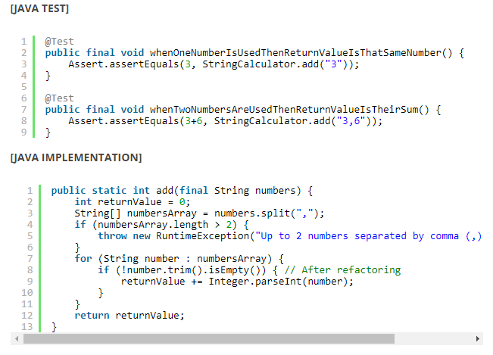
Best Practices: Naming Convention

Slide 18
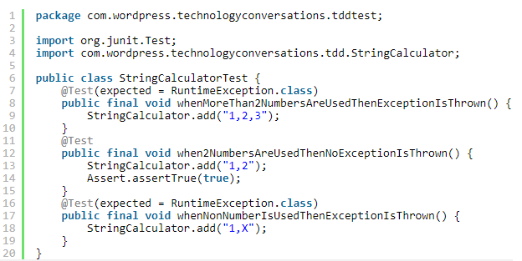
Best Practices: Naming Convention

Slide 19
Activity
Naming Practice
You have 1 minute to think about a test case
Use the pattern GIVEN/WHEN/THEN to build a sentence
Example:
Scenario – Calculate the tax
Test Case – Given a user earns $5000 salary, when tax rate is 20% then the tax is $1000

Slide 20
Best Practices: Processes
Write Test Before Implementation
Ensures that testable code is written
Ensures that every line of code gets tests
Developer focus on requirements before coding
Write Code Only If Test Failed
Ensure test does not work without implementation
Ensure new function is needed for new requirement
Rerun All Tests Before Code Change
Ensure no side-effect caused by code changes
Only focus on new piece of code change
Safe refactoring

Slide 21
Best Practices: Development
Write the simplest code to pass test
Avoid unnecessary features
Write Assertion First, Code Later
Clarifies the purpose of requirement earlier
No Dependencies between Tests
Each test should be independent
Dependency may cause false test result
Reduce the complexity to reorganize test cases if requirement has significant change

Slide 22
Benefits
Save time for retest
Easy and safe refactoring
Increase quality and test coverage
Product better design
Notes:
2 minutes

Slide 23
You still have to do…
Unit testing
Integration testing
UI / UX Testing
Web Content Accessibility Guidelines (WCAG) 2.0
Regression
Notes:
2 minutes

Slide 24
Questions?

Slide 25
Exercise 1 – Individual Exercise

Slide 26
Summary
What is TDD?
Benefits of TDD
Conventional approach vs TDD approach
TDD Best Practice

